Slide 1


JAN EVANGELISTA PURKYNĚ UNIVERSITY · ÚSTÍ NAD LABEM
Technology and Knowledge Transfer Centre
Turning academic research into real-world impact.
www.ujep.cz

Slide 2

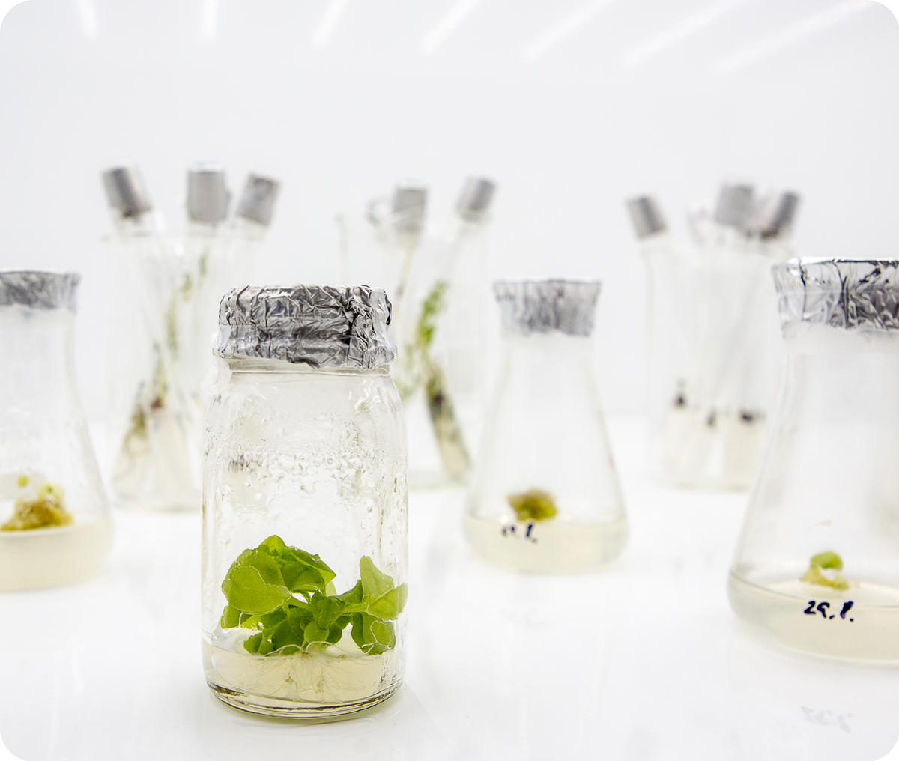




THE BASICS
What is “transfer”?
It is the process of delivering knowledge from academia into the applied sphere — both technologies and the know-how behind them.
WHO PUTS IT TO WORK
Industrial companies
Municipalities
Hospitals, Non-profit organisations
Non-profit organisations, etc.
02

Slide 3
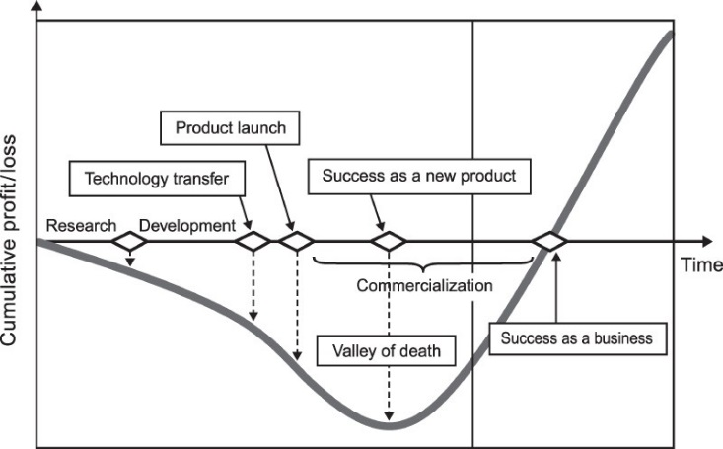
REFERENCE
The commercialisation process
10

Slide 4
BY THE NUMBERS · UNITED STATES vs. CZECHIA
Universities' R&D spending vs. licensing income
UNITED STATES
CZECHIA
3.2%
0.017%
of R&D spending comes back as licensing income
of R&D spending comes back as licensing income
R&D SPEND
LICENSING INCOME
R&D SPEND
LICENSING INCOME
$117.7 bn
appx $3.8 bn
appx 30 bn CZK
appx 5 mil. CZK
Even in the U.S., barely 3 cents of every research dollar returns through licences — in Czechia, almost nothing. Licensing income was never the point of transfer.
Sources: NSF HERD FY2024 & AUTM Licensing Survey (US); ČSÚ 2024 (CZ). Figures rounded; licensing income is highly concentrated in a few institutions.

Slide 5
WHAT TRANSFER IS REALLY FOR
Transfer isn’t about making money.
It’s about making research matter.
16

Slide 6



WHAT IT’S REALLY BUILT ON
Three pillars of transfer
1
2
3
Impact, not income
Public investment, returned
People & ecosystem
Science doesn’t end with publication. It ends when someone uses it. Transfer is the last, hardest metre from knowledge exists to knowledge helps.
Research is largely paid by taxpayers. Transfer returns that investment to society - as medicines, products, companies and jobs. As value, not an invoice.
Transfer trains people, not just patents: students in entrepreneurship, researchers in working with industry, regions in building companies — value that dwarfs licensing cheques and flows back to the university.
17

Slide 7

HOW IT HAPPENS
Forms of transfer
1
Licensing or transfer of IP rights Patents, know-how and software licensed or assigned.
2
Contract research Joint projects and commissioned research.
3
Cooperative research Shared programmes with partners.
4
Spin-offs & start-ups New companies, with or without an equity stake (sometimes via an SPV).
5
Consulting & open sharing Expertise, training, open access / open data — within the limits of the law.
05

Slide 8
THE ROAD TO MARKET
From idea to commercialisation
1
I have an idea / a pilot R&D result
5
Notification to the employer
2
Initial analysis & commercial-potential estimate
6
Intellectual-property protection
3
Define the “product / service” — Lean Canvas
7
Publication — yes, only here!
4
Proof of Concept
8
Commercialisation / application of the result
Source: Petr Suchomel, Director of STP, UPOL
07

Slide 9






SAFEGUARDING RESULTS
Intellectual property protection
Patents
Utility models
Trademarks
Industrial designs
Software
Copyright
11

Slide 10

SUCCESS STORIES · 1 / 3
IOCB Prague — antivirals that changed the world
Prof. Antonín Holý’s research led to essential antivirals against HIV/AIDS — in particular tenofovir. The compounds were licensed to Gilead Sciences (USA), earning the institute extraordinary, long-term royalties.
up to
These funds powered a sweeping modernisation of the institute, support for basic research, and a full technology-transfer ecosystem (IOCB Tech, i&i Prague). The commercialisation of tenofovir is one of the most successful examples of moving Czech academic research into global pharmaceutical practice.
3 bn CZK
in licensing income in some years
13

Slide 11

SUCCESS STORIES · 2 / 3
DIANA Biotechnologies — diagnostics at scale
A biotechnology spin-off founded by IOCB. It developed ultrasensitive PCR detection of pathogens and proteins, which the company turned into PCR diagnostic tests — especially for COVID-19.
6 M+
€3.5 M
It collaborates with university laboratories in both research and production, and has won awards such as Deloitte Fast 50 and EY Entrepreneur of the Year — a model example of academic knowledge returning to the commercial sector.
PCR tests produced — the largest Czech maker of Covid tests
private capital raised for research & production
14

Slide 12
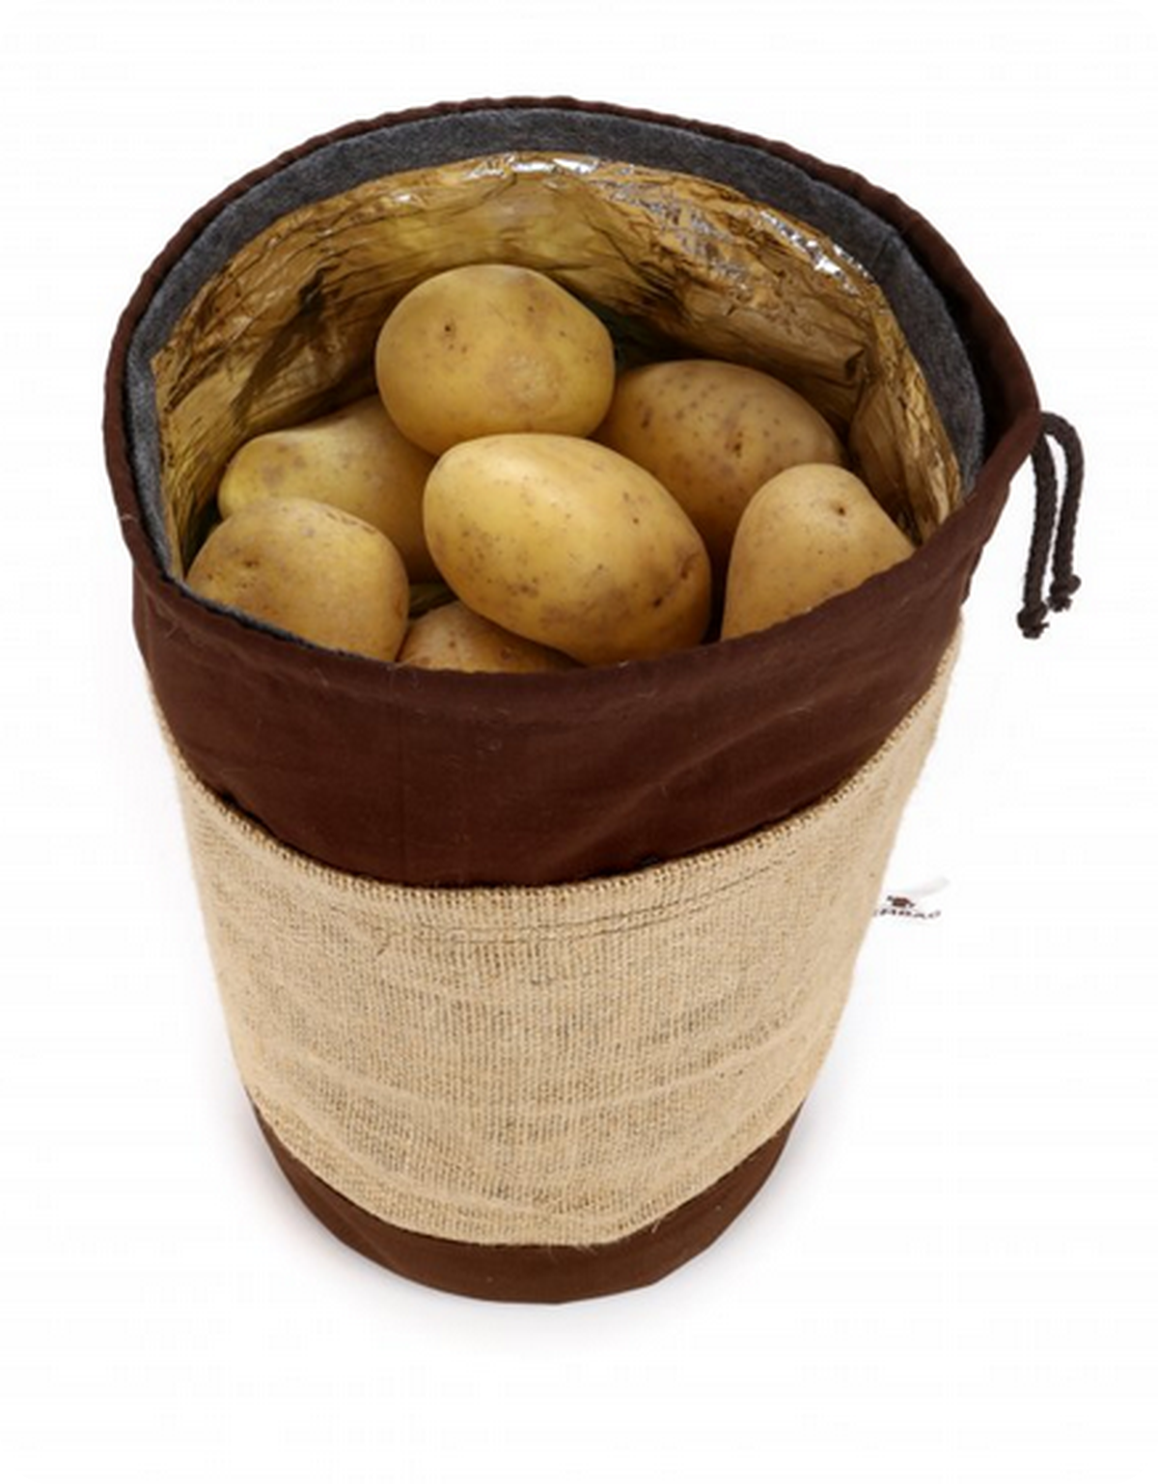

SUCCESS STORIES · 3 / 3
ZEMBAG — research you can hold
“Zembag is a unique three-layer bag for vegetables that allows long-term storage at room temperature. And it’s beautiful, too.”
CZU (Czech University of Life Sciences). The innovation was transferred by the spin-off Terpenix s.r.o. in 2013 to commercialise research on natural bioactive substances. Terpenix licensed the technology and the ZEMBAG™ brand, which it actively uses to make and distribute the product.
15

Slide 13

With enthusiasm, a person achieves more
than with theorising and pragmatism.
16

Slide 14

Success is walking from failure to failure
with no loss of enthusiasm.
WINSTON CHURCHILL
18

Slide 15


WE’RE HERE FOR YOU
Let’s talk about transfer
MP
MH
HP
Ing. Michal Pácal
Ing. Mgr. Marek Hartych
Bc. Hanuš Petržílka
michal.pacal@ujep.cz
marek.hartych@ujep.cz
hanus.petrzilak@ujep.cz
+420 775 959 635
+420 608 544 25
+420 475 286 354
www.transfer.ujep.cz
19

